Slide 1

بِسْمِ اللهِ الرَّحْمٰنِ الرَّحِيْمِ
Enhancing Image Steganography Technique for Secure Communication
By:
Names | Roll Number | Designations
Ubaidullah Qureshi | 20IT-16 | Leader
Waqas | 20IT-07 | Member
Sawera | 20IT-64 | Member
FYP 1
Supervisor: Dr. Saima Siraj Soomro
Department of Information Technology

Slide 2
Contents
Introduction
Literature Review
Problem Statement
Aim & Objectives of Research
Proposed Methodology
Work Plan
List of References

Slide 3
Introduction
Steganography is like a secret way of writing messages. It's a way to hide messages so that only the person sending it and the person meant to get it know it's there. Others wouldn't even know there's a message hidden [1].
Steganography is like the skill of "hidden writing. It involves methods to conceal information within things called "Cover Objects [2].

Slide 4
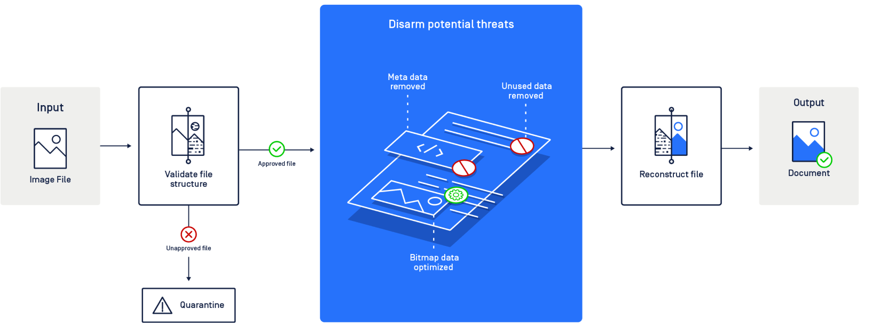
Introduction (cont..)
Figure 1. A diagram depicting how OPSWAT Deep CDR disarms threats in images

Slide 5
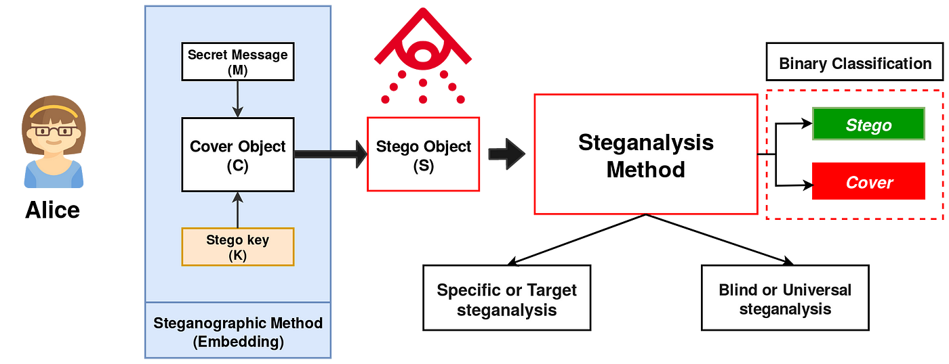
Introduction (cont..)
Figure 2. A diagram explain friendly introductions to steganalysis from medium.com

Slide 6
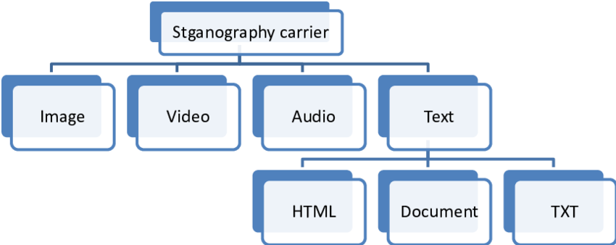
Types of Steganography:
Figure 3. From Steganography Techniques : A Comparative Research Case Study | Semantic Scholar[4]

Slide 7
TABLE 1. Types of Image Steganography
Type of Steganography | Description
Text Steganography | Concealing data within textual content, such as documents or emails [3].
Image Steganography | Hiding information within digital images, often by altering pixel values imperceptibly [4].
Audio Steganography | Embedding data within audio files, exploiting imperceptible modifications in sound waves [5].
Video Steganography | Concealing data within digital video files, typically by modifying frames or compression techniques [6].
Network/Protocol Steganography | Concealing data within network protocols or traffic, allowing covert communication over networks [7].

Slide 8
Literature Review:
Johnson and Smith came up with a way to hide messages in digital images using the Least Significant Bit (LSB) of each pixel. They replaced this bit with a bit from the secret message. However, this method can be easily detected by looking at the image, and it can't hold as much information as newer methods [8].

Slide 9
Literature Review:
Provos and Honeyman made steganography better by pointing out weaknesses in methods that rely on LSB (Least Significant Bit). They showed we need stronger ways to hide information. This pushed researchers to create algorithms that can resist different detection methods and tricks to uncover hidden data. Their ideas helped make steganography more secure and resistant to attacks [9].

Slide 10
Literature Review:
Fridrich and Goljan have played a big role in improving how we hide information in digital images. They've worked a lot on making strong methods for hiding data. Their teamwork has brought new ideas, like adaptive hiding and better ways to test how well hiding methods work. Their work keeps pushing the field forward, inspiring others to make even better ways to keep data hidden in digital images [10].

Slide 11
Literature Review:
Yang, Yao, and Tong have helped steganography by finding new ways to hide data and communicate securely. They look at complex methods and techniques to make hiding systems stronger and able to hold more data. They've made big contributions in areas like adaptive hiding, reversible hiding, and using deep learning to detect hidden data. Their work keeps steganography moving forward, tackling new problems and making sure information stays hidden securely [11].

Slide 12
Literature Review:
Zhang, Qiu, and Zhang have helped steganography by studying different ways to hide data and keep information safe. They've made new hiding methods, studied existing ones, and applied them to protect multimedia like images and videos. They've made big contributions in areas like watermarking, reversible hiding, and checking if multimedia has been tampered with. Their goal is to make hiding systems stronger and more reliable for real-world use, keeping digital communication and multimedia safe from harm [12].

Slide 13
Literature Review:
Li and Wang have helped steganography a lot by finding new and better ways to hide data securely. They study advanced techniques and methods to make hiding systems stronger and more secure. They've made important progress in areas like adaptive hiding, reversible hiding, and detecting hidden data. Their research is vital for moving steganography forward, tackling new problems, and making sure data stays hidden effectively and safely [13].

Slide 14
Literature Review:
Ker and their team have played a big role in making steganography better. They've worked on new ways to hide information securely, like in images or videos. Their research has helped create strong methods for hiding data and checking how secure they are. They've made important contributions in areas like hiding data in different parts of images or using different techniques to hide information. Their work keeps pushing steganography forward, inspiring others to find new ways to keep communication secure and data protected [14].

Slide 15
Literature Review:
Kapoor, Sood, and Mahajan have helped steganography by finding new ways to hide data and communicate securely. They've studied advanced techniques to make hiding systems stronger and able to hold more data. They've made important contributions in areas like adapting hiding methods, hiding data that can be reversed, and checking multimedia for tampering. Their research aims to make hiding techniques more secure and effective, dealing with modern challenges in digital communication and multimedia protection [15].

Slide 16
TABLE 2. Literature Review Summary (Continue)
Algorithm | Authors | Technology Applied | Advantages | Disadvantages
LSB Substitution | Johnson and Smith | Least Significant Bit (LSB) substitution | Simple and easy to implement | Vulnerable to visual attacks <br> - Limited capacity
LSB Vulnerability Highlighting | Provos and Honeyman | Analysis of LSB-based methods | Highlights weaknesses, fostering stronger algorithms | - No direct solutions <br> - Additional implementation efforts
Advanced Steganographic Techniques | Fridrich and Goljan | Adaptive hiding, improved testing methodologies | - Enhances security with adaptive hiding <br> - Improves testing for hiding techniques | - Increased computational resources <br> - Implementation complexity
Complex Data Hiding | Yang, Yao, and Tong | Adaptive hiding, reversible hiding, deep learning steganalysis | - - Enhances security and capacity <br> - Explores complex method | - Requires deep learning expertise <br> - Higher processing times

Slide 17
TABLE 2. Literature Review Summary:
Algorithm | Authors | Technology Applied | Advantages | Disadvantages
Multimedia Protection | Zhang, Qiu, and Zhang | Watermarking, reversible hiding, multimedia forensics | - Protects multimedia content <br> - Ensures tamper-proofing | - Quality degradation in watermarking <br> - Increased computational overhead
Advanced Data Concealment | Li and Wang | Advanced hiding techniques, reversible hiding, detection methods | Enhances security and effectiveness <br> - Addresses contemporary challenges | - Sophisticated detection methods <br> - Potential performance impact
Enhanced Steganographic Systems | Ker et al. | Novel hiding techniques, advanced detection methods | - Enhances security of hiding systems <br> - Explores innovative methods for concealing data | - Extensive testing required <br> - Implementation challenges
Secure Communication Techniques | Kapoor, Sood, and Mahajan | Adaptive hiding, reversible hiding, multimedia forensics | - Enhances security and reliability of communication <br> - Addresses modern challenges in digital communication | - Increased computational requirements <br> - Requires specialized tools

Slide 18
Problem Statement
In today's digital world, keeping sensitive information safe during communication is vital. Traditional methods like encryption might not always be enough to protect data from prying eyes. That's Why, While numerous applications exist for image steganography, specifically, a lack of apps designed to securely hide data within images, particularly with encryption and decryption capabilities using a key. Such an application would address a significant need, allowing individuals to safeguard sensitive information in their daily digital interactions. Moreover, it is essential that the application be user-friendly and intuitive to ensure widespread adoption and ease of use by a diverse range of users.

Slide 19
Aim & Objectives:
Aim
The aim of this project is to Enhancing a secure and efficient image steganography mobile app using the Android Studio tool.
Objectives
Ensure the security of hidden messages through encryption techniques.
Create a user-friendly interface for easy message embedding and extraction.
Evaluate system performance, security, and usability comprehensively.
Improve the system's ability to handle changes to images without messing up the hidden message inside.

Slide 20
Methodology
1. Requirement Gathering and Analysis:
2. Design:
3. Development:
4. Testing:
5. Deployment:
6. User Feedback and Maintenance:

Slide 21
Methodology
Requirement Gathering and Analysis:
Identify the requirements for the app, such as supported image formats, encryption methods, and user interface preferences.
Design:
Design the user interface, including screens for selecting images, encrypting data, embedding, and extracting hidden data.
Plan the architecture, considering components such as activities, fragments, services, and data storage.
Development:
Implement the user interface using XML layouts and design elements.
Write code for image selection, encryption, embedding, extraction, and other functionalities.
Ensure compatibility with various Android versions and screen sizes.
Testing:
Perform unit testing for individual components and functionalities.
Conduct integration testing to ensure smooth interaction between different modules.
Test the app on various devices and screen sizes to check for compatibility and responsiveness.
Deployment:
Package the app into an APK file.
Upload the APK to the Google Play Store or distribute it through other channels.
Ensure that necessary permissions and app metadata are provided.
User Feedback and Maintenance:
Gather user feedback to identify any bugs or usability issues.
Release updates to address issues and add new features based on user feedback.
Monitor app performance and address any compatibility issues with new Android versions.

Slide 22
List of References
[1] Moerland, T., “Steganography and Steganalysis”, Leiden Institute of Advanced Computing Science.
[2] Silman, J., “Steganography and Steganalysis: An Overview”, SANS Institute, 2001.
[3] Moerland, T., “Steganography and Steganalysis”, Leiden Institute of Advanced Computing Science,
[4] Johnson, N.F. & Jajodia, S., “Exploring Steganography: Seeing the Unseen”, Computer Journal,
February 1998
[5] Artz, D., “Digital Steganography: Hiding Data within Data”, IEEE Internet Computing Journal, June 2001
[6] Kapotas SK Skodras AN, (2008) A new data hiding scheme for scene change detection in H. 264 encodedvideo sequences, In: 2008 IEEE. International Conference on Multimedia and Expo
[7] Ahsan, K. & Kundur, D., “Practical Data hiding in TCP/IP”, Proceedings of the Workshop on Multimedia Security at ACM Multimedia, 2002.
[8] Johnson, Smith's . "A survey of steganographic techniques." Information hiding

Slide 23
List of References
[9] Provos, N., & Honeyman, P. (2003). IEEE Security & Privacy, 1(3), 32-44.
[10] Fridrich, J., Goljan, M., & Du, R. (2009). Proceedings of the ACM Workshop on Multimedia and Security, 27-36.
[11] Yang, B., Yao, H., & Tong, W. (2015). International Journal of Multimedia and Ubiquitous Engineering, 10(2), 377-386.
[12] Zhang, Y., Qiu, M., & Zhang, Y. (2020). IEEE Access, 8, 28439-28455.
[13] Li, B., & Wang, Y. (2018). IEEE Transactions on Information Forensics and Security, 13(7), 1738-1752.
[14] Ker, A. D. (2016). International Journal of Computer Applications, 136(8), 10-14.
[15]Kapoor, D., Sood, A., & Mahajan, A. (2017). Procedia Computer Science, 122, 667-674.

